Slide 1


FROM DAY ONE
From Day One:​
Your Mental Health Matters
www.naminyc.org
Notes:
Welcome to [ORGANIZATION]. As part of our commitment to supporting you in your new role, we want you to know that we care about your overall mental health and well-being. Today, we will discuss what mental health is, how it relates to the workplace, strategies to look after your mental health, and company resources that can provide additional support.
We know starting a new job can be stressful, and discussing mental health in a new setting might feel uncomfortable. Shortly, we will watch a video of one of our senior leaders sharing their mental health journey and tips for balancing roles and responsibilities at our firm.
This presentation is supported by the NAMI-NYC Workplace Mental Health Initiative which provides custom support to employers seeking to promote employee wellbeing and supportive mental health practices in the workplace

Slide 2

FROM DAY ONE
We Value Employee Well-Being
  Add your company’s value statement
www.naminyc.org
Notes:
At [ORGANIZATION], we believe that employee well-being is fundamental to our success. Our commitment to your mental health and overall well-being is integrated into our company values.
[Read Company’s Value Statement.].
Feel free to take a moment to reflect on our values and think about how they resonate with you. We are here to support you in every way we can.

Slide 3

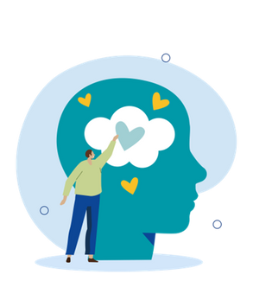
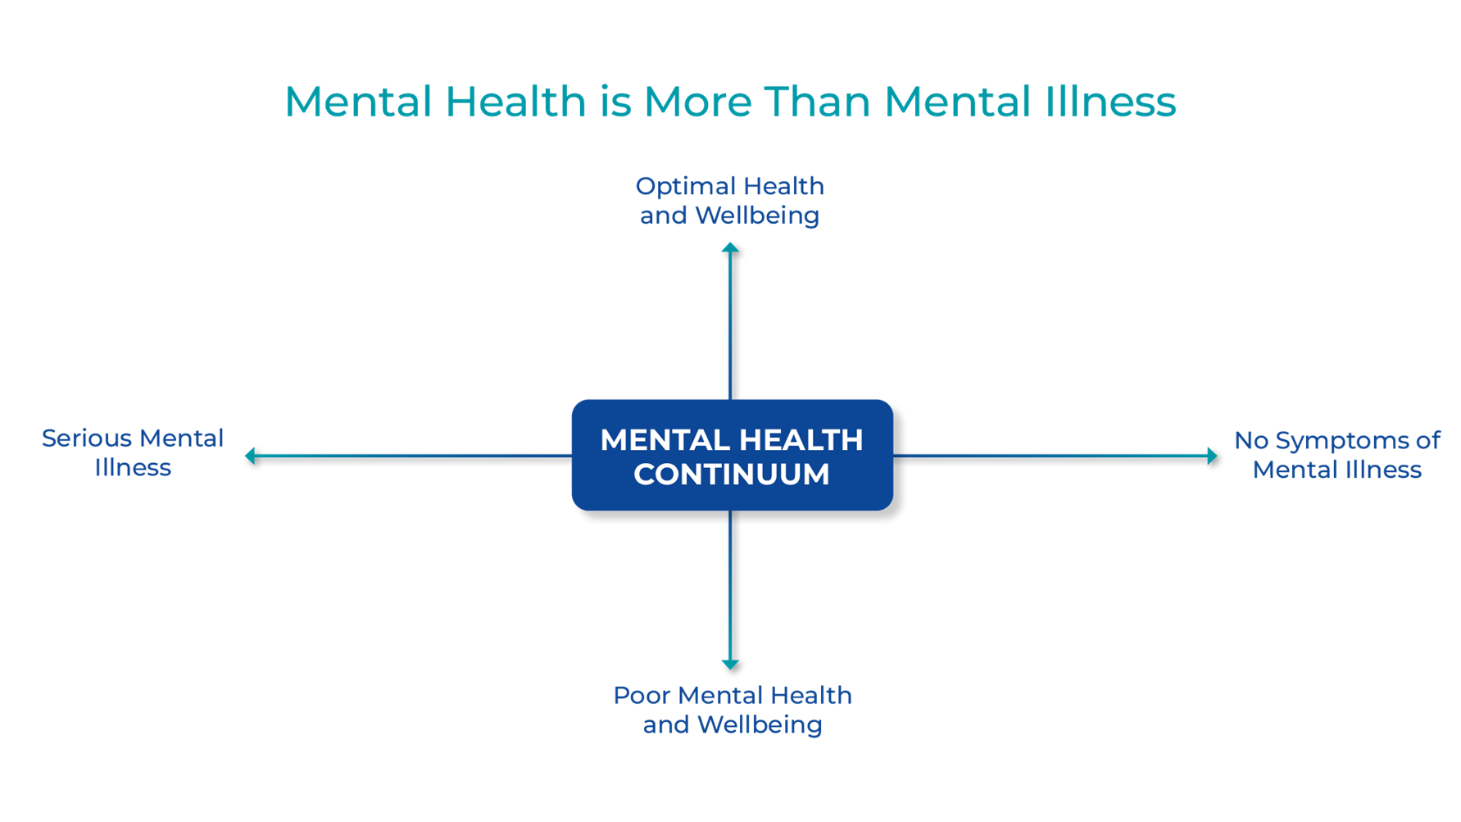
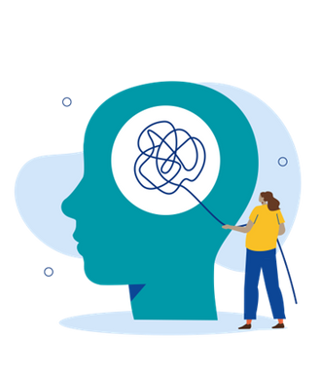
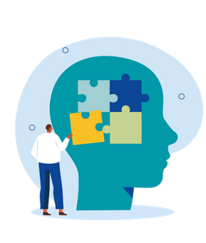
FROM DAY ONE
Mental Health Affects Us All
Optimal
mental health
Mental illness
No symptoms
of mental illness
Mental health challenges
www.naminyc.org
Notes:
Let's start by acknowledging that we all have mental health, just as we all have physical health. We have minds, and therefore, we have mental health, in the same way that we have bodies and physical health.
This graphic illustrates that mental health is a continuum. On this continuum, someone living with a diagnosed mental illness can thrive in the workplace and experience optimal mental health. At the same time, someone who does not live with a mental illness may face mental health challenges during particularly stressful periods of life—and that’s perfectly normal.
It's important to understand some common terms used when discussing mental health:
Mental Health: A state of well-being where individuals can cope with normal stressors, work productively, and contribute to their communities.
Mental Health Challenges: Recognize that mental health exists on a spectrum, and everyone may face challenges at different times.
Mental Illnesses: Conditions where thoughts, mood, and behaviors negatively affect day-to-day functioning. Millions of people are affected each year. For instance, one in five US adults experience mental illness annually, and one in twenty experience a serious mental illness.
The good news is that with treatment, most people improve significantly. In one study, over 80% of employees who received treatment for mental illness recover and reported improved productivity and job satisfaction.
Understanding this continuum helps us recognize that mental health can fluctuate, and it's essential to provide support and resources to everyone, regardless of where they fall on the spectrum.

Slide 4
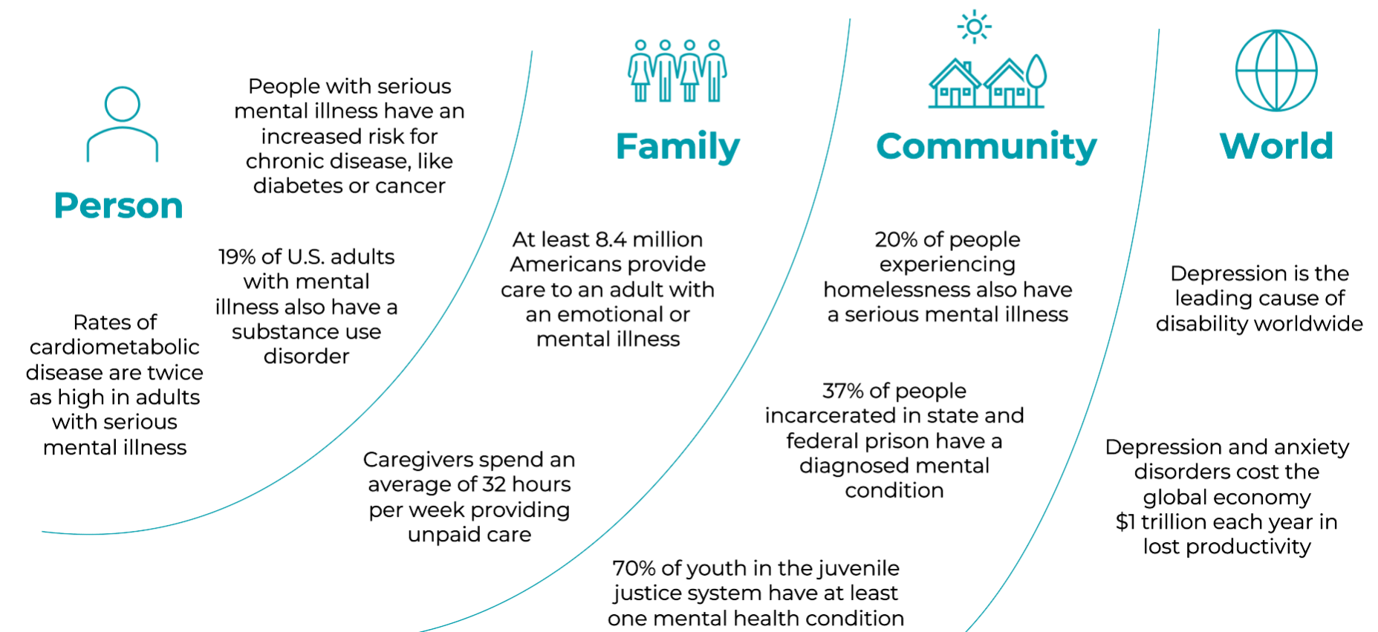
FROM DAY ONE
www.naminyc.org
Notes:
Let's start by acknowledging the broader impact of mental health. When someone experiences a mental illness, it can make everyday life and maintaining recovery challenging. However, these challenges extend beyond the individual, affecting our families, our communities, and the world at large.
This graphic helps illustrate how mental health impacts us at different levels:
In addition to impacting mental health, mental illness can significantly affect an individual's physical health, leading to increased risks for chronic diseases.
Mental illness also impacts the loved ones of the person experiencing the illness. At least 8.4 million caregivers provide support for someone with mental illness. We offer support for caregivers to help them manage their responsibilities and maintain their well-being.
Mental illness affects our communities in significant ways. For example, a substantial percentage of people experiencing homelessness and those incarcerated have serious mental health conditions. By addressing mental health needs, we can work towards healthier, more stable communities.
On a global scale, mental health issues like depression and anxiety are leading causes of disability and have a massive economic impact, costing the global economy $1 trillion annually in lost productivity. Supporting mental health can lead to better global health outcomes and economic benefits. Understanding that mental health issues have a wide-reaching impact underscores the importance of supporting mental health within our organization. By doing so, we contribute to better outcomes for individuals, their families, our community, and even globally.
[Feel free to mention any other community support or initiatives your company has that partner with nonprofits, as well as ways you support the community in which you are working.]

Slide 5

FROM DAY ONE
Signs of Mental Health Challenges
Feels
  Excessive irritability/anger​
  Extreme worry​
  Intense highs and lows​
  Easily overwhelmed
Thinks
  Confusion
  Changes in concentration​
  Persistent negative thoughts​
  Suicidal or self-harm thoughts​
Acts
  Withdrawn/avoidant​
  Drop in performance​
  Late or not showing up​
  Erratic behavior or speech
Looks
  Exhausted, low energy​
  Fidgety, nervousness​
  Drastic change in appearance​
  Alcohol/drug use​
www.naminyc.org
Notes:
One of the first steps in supporting mental health in the workplace is recognizing when something might be going on—either with yourself or those around you. Mental health challenges can show up in different ways, and it's essential to be aware of the signs.First, let's look at changes in how a person acts. You might notice someone becoming withdrawn from social activities or avoiding interactions. There could also be a noticeable drop in their performance at work, frequent lateness, or not showing up at all. Additionally, erratic behavior or speech might be a sign of mental health challenges.
Next, consider changes in appearance. An individual may appear exhausted or have low energy levels. You might see signs of nervousness or fidgeting, drastic changes in their appearance, or even evidence of alcohol or drug use.Then, there are emotional indicators, which we categorize under feels. These include excessive irritability or anger, extreme worry, and intense mood swings. An individual might feel easily overwhelmed by tasks that normally wouldn’t be a problem.
Lastly, think about changes in thought patterns. Someone struggling with their mental health might experience confusion or have difficulty concentrating. They could also have persistent negative thoughts, and in severe cases, thoughts of self-harm or suicide.
It's important to focus on behavior changes that persist over a period of two weeks. These signs don’t necessarily mean someone has a mental illness, but they can help identify changes in ourselves and others in the workplace. Recognizing these warning signs allows us to respond early to burnout or stress and seek additional support if necessary.
In the United States, it takes an average of eleven years to receive treatment after the onset of symptoms. While many of these warning signs are experiences we might all face at some point, if they are impacting your life negatively or lasting a long time, reaching out to a professional can be beneficial. We have a host of resources to help you along the way.

Slide 6

FROM DAY ONE
Impact on Performance
  Decreased motivation
  Reduction in cognitive performance and working memory
  Poor decision-making
  Difficulty communication
  Absent more and less productive when you are working
www.naminyc.org
Notes:
Mental health challenges can significantly impact workplace performance, and it’s important to understand how these issues might affect you or your colleagues. Let’s discuss some common ways that poor mental health can manifest in a work environment.
First, let’s consider decreased motivation. If you’re struggling with your mental health, you might find it harder to feel motivated or enthusiastic about your tasks or projects. This could lead to procrastination, feeling overwhelmed by your workload, and possibly missing deadlines.
Next, think about reduced cognitive performance and working memory. Mental health issues can make it challenging to concentrate or remember important details. You might have trouble staying focused during meetings, or you might find it difficult to recall key points from a recent discussion or training session.
Another area that might be affected is decision-making. Poor mental health can impair your judgment and make it harder to make clear, effective decisions. This might result in more mistakes or hesitations in taking action, which can slow down your work progress and affect team outcomes.
Communication is also often impacted by mental health challenges. You might find it difficult to express your thoughts clearly or engage in productive discussions with your colleagues. This can increase misunderstandings and create barriers to effective teamwork.
Additionally, mental health issues can lead to increased absenteeism and reduced productivity. If you’re struggling, you might need to take more time off to manage your health, which can disrupt your work schedule. Even when you are at work, you might not be able to perform at your best, further affecting overall productivity.
This is why we place such a strong emphasis on supporting your mental health. Our goal is to help you be happy, healthy, and perform your best at work. We are committed to providing the necessary support to ensure that you can thrive in your role and contribute effectively to our team.

Slide 7

FROM DAY ONE
We Value Your Mental Health
  Insert video of your mental health champion
www.naminyc.org
Notes:
Supporting mental health is vital for individual and team performance. We at [ORGANIZATION] are committed to supporting mental health across the spectrum.
Now, we will hear from [LEADER NAME] on why mental health is important to them.
[Insert video of the mental health champion]

Slide 8


Support Your
Well-Being
Notes:
Now, let's shift our focus to some practical steps you can take to support your mental well-being. Taking care of your mental health is crucial, not only for your personal life but also for your professional success.

Slide 9
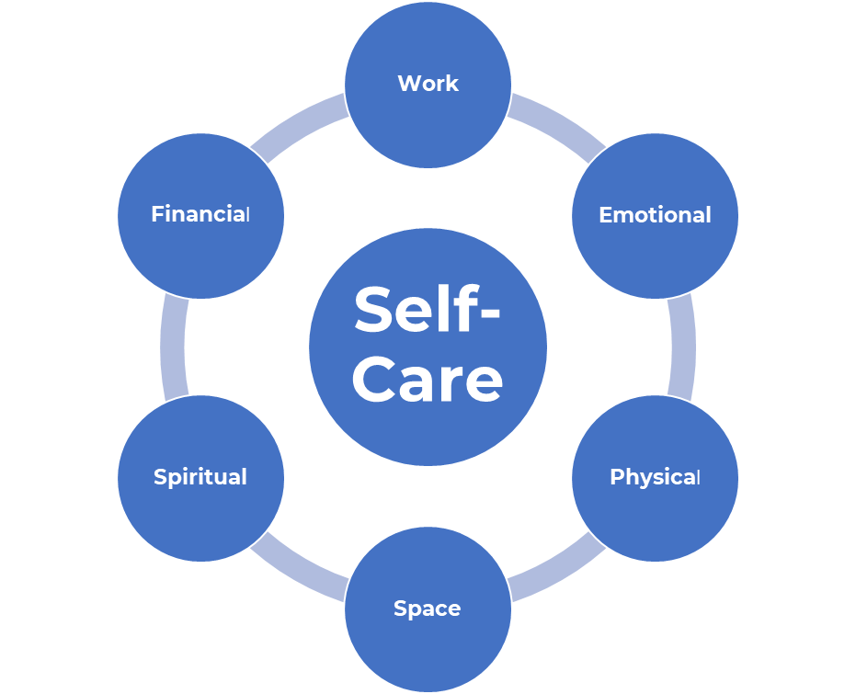
FROM DAY ONE
Self-Care & Your Well-Being
www.naminyc.org
Notes:
Self-care is an important part of taking care of our overall physical and mental well-being. There are many ways to practice self-care and listening to our bodies and minds can help us identify what would be most helpful at different moments. It can be helpful to think about self-care as doing things that can enhance our well-being, such as exercise and eating right, as well as ways to cope with and protect against stress and negative feelings, such as taking some time to watch a movie or making fun plans with friends. All types of self-care are important and if we practice self-care regularly, it will help us be more resilient when we face challenges.
We know that it can be challenging, particularly when starting a new role, to find time to do these things. Our organization strives to support you by prioritizing all aspects of wellness and making many resources available to support you. We will review these in a moment.

Slide 10



FROM DAY ONE
Set Yourself Up for Success
Clarify Roles and
Expectations
Take Your Breaks
Practice Mindfulness
www.naminyc.org
Notes:
Starting a new job can be stressful, but here are three quick tips to help you manage this transition and set yourself up for success:
Clarify Roles and Expectations: When you’re new, it’s crucial to have a clear understanding of your roles and responsibilities. Regularly reviewing these with your manager ensures that you both are on the same page, which helps prevent burnout and unnecessary confusion. Clear expectations and regular feedback can provide a sense of direction and help you feel more confident and capable in your new role.
Take Your Breaks: Establishing a routine that includes regular breaks is essential for maintaining a healthy work-life balance, especially when starting a new job. Taking breaks helps you recharge, maintain focus, and return to work with a fresh perspective. Scheduling these breaks early on prevents work from spilling over into your personal time and helps you manage stress more effectively.
Practice Mindfulness: Mindfulness techniques, such as meditation or deep breathing exercises, can be incredibly helpful in managing the stress and information overload that often come with starting a new job. Practicing mindfulness regularly helps you recognize anxiety, focus on the present moment, and build resilience. This can make it easier to cope with the challenges and uncertainties of a new environment, helping you to stay calm and focused.
By incorporating these quick tips into your routine, you can navigate the challenges of starting a new job more effectively and set a strong foundation for your success at [ORGANIZATION].

Slide 11

FROM DAY ONE
We’re Here to Support You
  Employee Assistance Program
  Meditation apps
  Additional counseling service apps
  Health insurance information related to behavioral health
  Employee resource groups
  Info on accommodations
  Buddy/mentoring programs
  Caregiver resources
www.naminyc.org
Notes:
We believe that supporting your mental health is fundamental to your overall well-being and success. We have a range of resources available to help you navigate any challenges and support your mental health.
Here are some of the key resources we offer:
[Customize this section with your company’s specific resources. Below are examples you can include.]
Employee Assistance Program (EAP): Our EAP provides confidential counseling services and can be accessed by both employees and their family members. This service offers support for personal and work-related issues, helping you and your loved ones manage stress, mental health concerns, and more.
Meditation Apps: We provide access to premium subscriptions for meditation and mindfulness apps. These apps offer a variety of guided meditations and relaxation techniques that can help you manage stress and improve your mental well-being.
Additional Counseling Service Apps: In addition to our EAP, we offer access to other counseling service apps that provide online therapy sessions and mental health support. These apps make it easy to connect with licensed therapists from the comfort of your home.
Health Insurance Information Related to Behavioral Health: Our health insurance plans include comprehensive behavioral health coverage. This ensures you have access to the necessary treatments and support for any mental health conditions.
Feel free to take advantage of these resources to support your mental health and overall well-being. We encourage you to reach out if you need assistance or have any questions about the resources available to you.
We are committed to providing a supportive environment where you can thrive both personally and professionally. Your well-being is our priority, and we are here to support you every step of the way.

Slide 12
FROM DAY ONE
Reflection Exercise
  How does it impact you to hear a leader talk about mental health?
  Practicing regular self-care can help us during stressful times. What aspects of self-care will you prioritize while starting a new role?
  What's one workplace wellness resource that you're now interested in checking out?
www.naminyc.org
Notes:
We know you are receiving a lot of information right now! We wanted to take a few minutes to think about what we have just talked about and how we can use this knowledge to help guide us in our new role. Please take a few minutes to reflect on these questions. You won’t need to share your responses.
[Consider sharing your own responses to prompt reflection.]

Slide 13

FROM DAY ONE
Questions?
www.naminyc.org
Notes:
[Open the floor for any questions the new employees might have about mental health resources or the presentation.]

